Slide 1
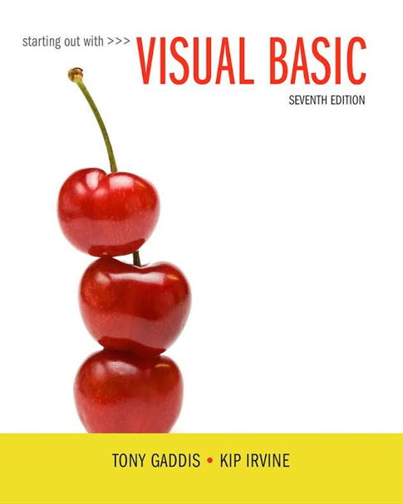
Starting out with Visual Basic®
Seventh Edition
Chapter 1
Introduction to Programming and Visual Basic
Copyright © 2017, 2014, 2011 Pearson Education, Inc. All Rights Reserved
Notes:
If this PowerPoint presentation contains mathematical equations, you may need to check that your computer has the following installed:
1) MathType Plugin
2) Math Player (free versions available)
3) NVDA Reader (free versions available)

Slide 2
Introduction
Name
Major
Hobbies
Work Experience
Interesting fact about you
Goals

Slide 3
Learning Objectives
1.1 Computer Systems: Hardware and Software
1.2 Programs and Programming Languages
1.3 More about Controls and Programming
1.4 The Programming Process
1.5 Visual Studio

Slide 4
Introducing Microsoft Visual Basic (1 of 2)
What is Visual Basic?
a software development system for creating applications on the Windows operating system
Commonly referred to as V B

Slide 5
Introducing Microsoft Visual Basic (2 of 2)
What can you do with Visual Basic?
Create applications with graphical windows, dialog boxes, and menus
Create applications that work with databases
Create Web applications and applications that use Internet technologies
Create applications that display graphics

Slide 6
1.1 Computer Systems: Hardware and Software

Slide 7
Computer Hardware
The term hardware refers to the computer’s physical components
A computer is not one device, but a system of devices
Major types of components include:
Central Processing Unit
Main memory
Secondary storage devices
Input devices
Output devices

Slide 8
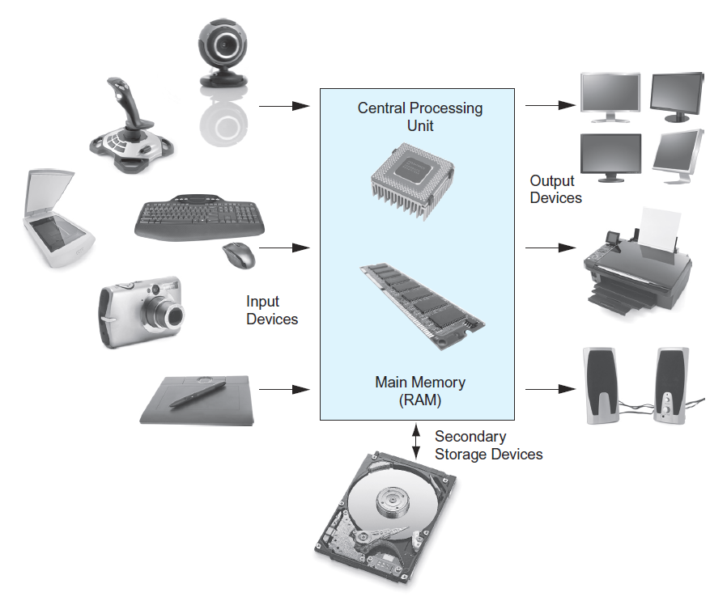
The Organization of a Computer System

Slide 9
1. The C P U
The central processing unit, or C P U, is the part of a computer that actually runs programs
The most important component
Without it, the computer could not run software
Fetches instructions one by one
A program is a set of instructions a computer’s C P U follows to perform a task
Instructions are stored in memory as binary numbers
A binary number is a sequence of 1’s and 0’s

Slide 10
2. Main Memory
Think of main memory as the computer’s work area
Holds instructions and data needed for programs that are currently running
Commonly known as random-access memory, or just RAM
C P U can quickly access data at any random location
Used as temporary storage
Contents are lost when power is turned off

Slide 11
3. Secondary Storage
Most common secondary storage device is the disk drive
Records data magnetically on a circular disk
Other types of secondary storage devices include:
External disk drives
Connects to one of the computer’s communication ports
U S B drives
Small devices that plug into a computer’s U S B port
Optical devices such as C D s and D V D s
Data is encoded using a series of pits on the disc surface

Slide 12
4. Input Devices
Input is any data the computer collects from the outside world
The device that collects and sends data to the computer is called an input device
Common input devices:
Keyboard
Mouse
Digital camera
Disk and optical drives can be input devices
If their data is retrieved and loaded into main memory

Slide 13
5. Output Devices
Output is any data the computer sends to the outside world
A sales report, list of names, graphic images, or a sound
Data is sent to an output device, which formats and presents it
Common output devices:
Monitor
Printer
Disk and optical drives can be output devices
If the C P U sends them data to be saved

Slide 14
Software
Software refers to the programs that run on a computer
There are two general categories of software:
Operating systems
An operating system or O S is a set of programs that manages the computer’s hardware devices and controls their processes
Windows, Mac O S, and Linux are all operating systems
Application Software
Application software refers to programs that make the computer useful to the user
Word processing, spreadsheet, and database packages are all examples of application software

Slide 15
1.2 Programs and Programming Languages

Slide 16
What is a Program?
Computers can only follow instructions
A computer program is a set of instructions on how to solve a problem or perform a task
In order for a computer to compute someone’s gross pay, we must tell it to perform the steps on the following slide

Slide 17
Computing Gross Pay
Figure 1-2 Program steps—Wage Calculator application
Display a message on the screen: How many hours did you work?
Allow the user to enter the number of hours worked.
Once the user enters a number, store it in memory.
Display a message on the screen: How much do you get paid per hour?
Allow the user to enter an hourly pay rate.
Once the user enters a number, store it in memory.
Once both the number of hours worked and the hourly pay rate are entered, multiply the two numbers and store the result in memory as the gross pay.
Display a message on the screen that shows the gross pay. The message must include the result of the calculation performed in Step 7.
This well-defined, ordered set of steps for solving a problem is called an algorithm

Slide 18
States and Transitions
Memory snapshots show program states
Program Starting State
Store hourly pay rate in memory
Snapshot after Step 6
hours worked | 20
hourly pay rate | 25
amount earned | ??
hours worked | ??
hourly pay rate | ??
amount earned | ??
Store hours worked in memory
Snapshot after Step 3
Multiply hours worked by pay rate and store amount earned in memory
Snapshot after Step 7
hours worked | 20
hourly pay rate | ??
amount earned | ??
hours worked | 20
hourly pay rate | 25
amount earned | 500

Slide 19
Programming Languages
The steps in an algorithm must be stated in a form the computer understands
The C P U processes a series of 1’s and 0’s called machine language instructions
This is a tedious and difficult format for people
Programming languages allow us to use words instead of numbers
Special software called a compiler converts the programming language statements to machine language instructions

Slide 20
Popular Programming Languages
Language | Description
Visual Basic, C Sharp | Popular programming languages for building Windows and Web applications.
C, C++ | Powerful advanced programming languages that emphasize flexibility and fast running times. C++ is also object-oriented.
Java | Flexible and powerful programming language that runs on many different computer systems. Often used to teach object-oriented programming.
Python | Simple, yet powerful programming language used for graphics and small applications.
P H P | Programming language used for creating interactive Web sites.
JavaScript | Scripting language used in Web applications that provides rich user interfaces for Web browsers.

Slide 21
What is a Program Made of? (1 of 2)
Keywords (Reserved Words)
Words with special meaning that make up a high-level programming language, cannot be used for any other purpose
Operators
Special symbols that perform various operations on data
Variables
Used to store data in memory, named by the programmer
Syntax
Set of rules
Similar to the syntax (rules) of a spoken language, such as English, but must be strictly followed
If even a single syntax error appears in a program, it will not compile or execute

Slide 22
What is a Program Made of? (2 of 2)
Statements
Instructions made up of keywords, variables, and operators.
Called source code, or simply code
Procedures
Set of programming statements that perform a specific task
Comments (Remarks)
Ignored when the program runs, help human reader understand the purpose of programming statements
In Visual Basic, any statement that begins with an apostrophe (')

Slide 23
Graphical User Interfaces
The people who use a program are known as users
The part of a program that users interact with is known as the user interface
A graphical user interface or G U I (pronounced gooey) consists of one or more windows
A window is a rectangular area that contains other visual elements such as text and buttons

Slide 24
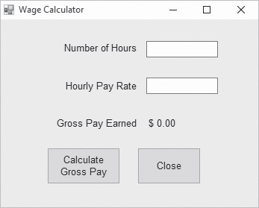
A Graphical User Interface

Slide 25
Objects and Controls (1 of 2)
Visual Basic is an object-oriented programming (O O P) language
An object is an item in a program that contains data and has the ability to perform actions
The data an object contains is referred to as properties, or attributes
The operations that an object can perform are called methods
A method is a special type of procedure that belongs to an object

Slide 26
Objects and Controls (2 of 2)
A control is specific type of object that usually appears in a program’s graphical user interface
The window that contains the other elements is known as a Form control
The small boxes that accept input are known as TextBox controls
The areas that simply display text are known as Label controls
The buttons that perform operations when clicked with the mouse are known as Button controls

Slide 27
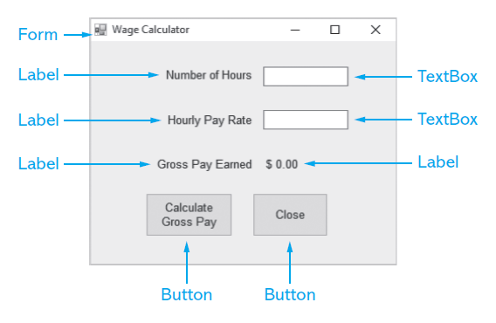
Types of Controls

Slide 28
Event-Driven Programming
The G U I environment is event-driven
An event is an action that takes place within a program
All Visual Basic controls are capable of detecting various events, such as:
Clicking a Button control
Changing the text in a TextBox control
In order for a control to respond to a specific event, you must write a special type of procedure called an event handler
Event handlers are also known as event procedures

Slide 29
1.3 More about Controls and Programming

Slide 30
Visual Basic Controls (1 of 2)
Tutorial 1-3 demonstrates how these controls work
Control Type | Description
Button | A rectangular button-shaped object that performs an action when clicked with the mouse
CheckBox | A box that is checked or unchecked when clicked with the mouse
ComboBox | A control that is the combination of a ListBox and a TextBox
Form | A window, onto which other controls may be placed
GroupBox | A rectangular border that functions as a container for other controls
HScrollBar | A horizontal scroll bar that, when moved with the mouse, increases or decreases a value
Label | A box that displays text that cannot be changed or entered by the user
ListBox | A box containing a list of items

Slide 31
Visual Basic Controls (2 of 2)
Tutorial 1-3 [continued]
Control Type | Description
PictureBox | A control that displays a graphic image
RadioButton | A round button that is either selected or deselected when clicked with the mouse
TextBox | A rectangular area in which the user can enter text, or the program can display text
VScrollBar | A vertical scroll bar that, when moved with the mouse, increases or decreases a value

Slide 32
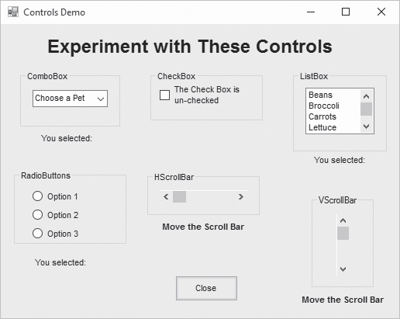
Control Demonstration Screen

Slide 33
The Name Property
All controls have properties
Each property has a value (or values)
Not all properties deal with appearance
The Name property establishes a means for the program to refer to that control
Controls are assigned relatively meaningless names when created
Programmers usually change these names to something more meaningful

Slide 34
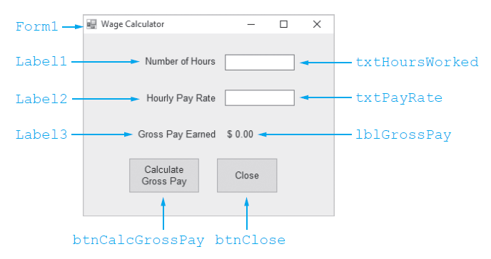
Examples of Control Names

Slide 35
Control Naming Rules and Conventions
Control names must start with a letter
Remaining characters may be letters, digits, or underscore
1st 3 lowercase letters indicate the type of control
t x t… for Text Boxes
l b l… for Labels
b t n… for Buttons
After that, capitalize the first letter of each word
t x t HoursWorked is clearer than t x t hoursworked

Slide 36
1.4 The Programming Process

Slide 37
Step 1 of Developing an Application
Clearly define what the program is to do
For example, the Wage Calculator program:
Purpose: To calculate the user’s gross pay
Input: Number of hours worked, hourly pay rate
Process: Multiply number of hours worked by hourly pay rate (result is the user’s gross pay)
Output: Display a message indicating the user’s gross pay

Slide 38
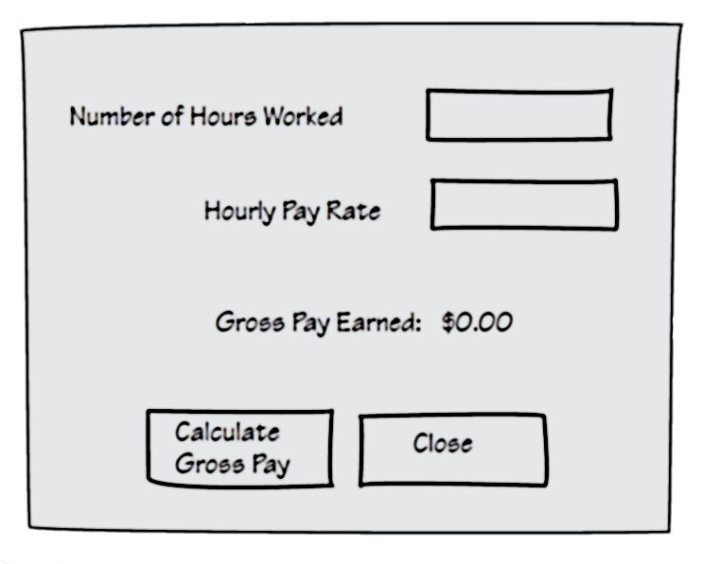
Step 2 of Developing an Application
Visualize the application running on the computer and design its user interface

Slide 39
Step 3 of Developing an Application (1 of 2)
Determine the controls needed
Control Type | Control Name | Description
Form | (Default) | A small form that will serve as the window onto which the other controls will be placed
Label | (Default) | Displays the message Number of Hours
Label | (Default) | Displays the message Hourly Pay Rate
Label | (Default) | Displays the message Gross Pay Earned
TextBox | t x t HoursWorked | Allows the user to enter the number of hours worked
TextBox | t x t PayRate | Allows the user to enter the hourly pay rate

Slide 40
Step 3 of Developing an Application (2 of 2)
Control Type | Control Name | Description
Label | l b l GrossPay | Displays the gross pay, after the b t n C a l c GrossPay button has been clicked
Button | b t n C a l c GrossPay | When clicked, multiplies the number of hours worked by the hourly pay rate; stores the result in a variable and displays it in the l b l GrossPay label
Button | b t n Close | When clicked, terminates the application

Slide 41
Step 4 of Developing an Application
Define the values of each control’s relevant properties
Control Type | Control Name | Text Property
Form | (Default) | "Wage Calculator"
Label | (Default) | "Number of Hours"
Label | (Default) | "Hourly Pay Rate"
Label | (Default) | "Gross Pay Earned"
Label | l b l GrossPay | "$0.00"
TextBox | t x t HoursWorked | ""
TextBox | t x t PayRate | ""
Button | b t n C a l c GrossPay | "Calculate Gross Pay"
Button | b t n Close | "Close"

Slide 42
Step 5 of Developing an Application
Determine the event handlers and other code needed for each control
Event Handler Name | Description
b t n C a l c GrossPay_Click | Multiplies the number of hours worked by the hourly pay rate; these values are retrieved from the t x t HoursWorked and t x t PayRate TextBox controls and the result of the multiplication is stored in the l b l GrossPay label’s Text property
b t n Close_Click | Terminates the application

Slide 43
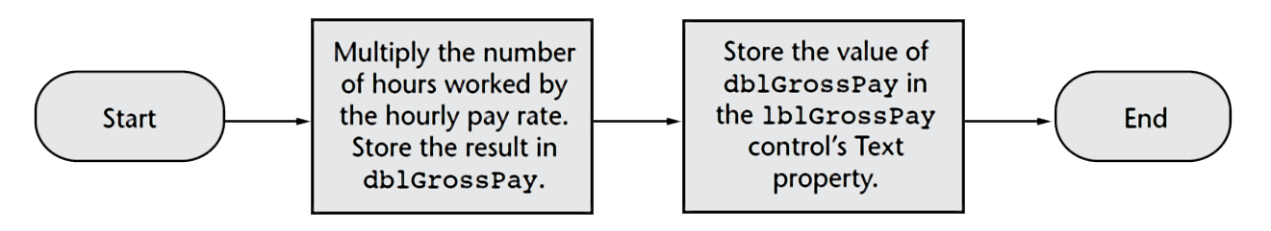
Step 6 of Developing an Application
Create a flowchart or pseudocode version of the code
A flowchart is a diagram that graphically depicts the flow of a method
Pseudocode is a cross between human language and a programming language
Store Number of Hours Worked × Hourly Pay Rate in the grossPay variable. Store the value of the value of the grossPay variable in the l b l GrossPay control’s Text property.

Slide 44
Step 7 of Developing an Application
Check the flowchart or pseudocode for errors:
Read the flowchart and/or pseudocode
Step through each operation as though you are the computer
Use a piece of paper to write down the values of variables and properties as they change
Verify that the expected results are achieved

Slide 45
Step 8 of Developing an Application
Start Visual Studio and create the forms and other controls identified in Step 3
This is the first use of Visual Studio
All of the previous steps have just been on paper
In this step you create the application’s user interface and arrange the controls on each from.
This is the portion of the application the user will see

Slide 46
Step 9 of Developing an Application
Use the flowcharts or pseudocode from step 6 to write the actual code
This is the second step on the computer
In this step you develop the methods behind the click event for each button
Unlike the form developed on step 8, this portion of the application is invisible to the user

Slide 47
Step 10 of Developing an Application
Attempt to run the application - find syntax errors
Correct any syntax errors found
Syntax errors are the incorrect use of an element of the programming language
Repeat this step as many times as needed
All syntax errors must be removed before the program will run

Slide 48
Step 11 of Developing an Application
Run the application using test data as input
Run the program with a variety of test data
Check the results to be sure that they are correct
Incorrect results are referred to as a runtime error
Correct any runtime errors found
Repeat this step as many times as necessary

Slide 49
1.5 Visual Studio and Visual Studio Express (the Visual Basic Environment)

Slide 50
What is Visual Studio?
Visual Studio is an integrated development environment, often abbreviated as I D E
Provides everything needed to create, test, and debug software including:
The Visual Basic language
Form design tools to create the user interface
Debugging tools to help find and correct programming errors
Visual Studio can be used to create applications with other languages such as C++ and

Slide 51
The Visual Studio Environment (1 of 2)
The Visual Studio environment consists of a number of windows
The Designer Window
Used to create an application’s graphical user interface
The Solution Explorer Window
Allows you to navigate among the files in a Visual Basic project
The Properties Window
Used to examine and change a control’s properties

Slide 52
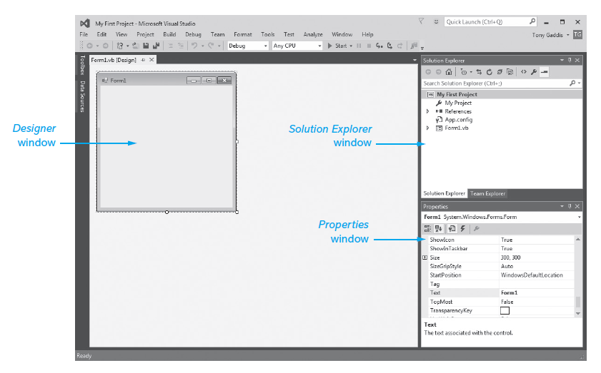
The Visual Studio Environment (2 of 2)

Slide 53
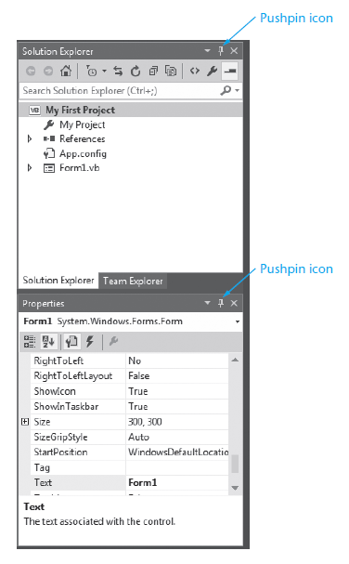
Auto Hide
Many windows have a feature known as Auto Hide
Allows for more room to view an application’s forms and code
Click on the pushpin icon to turn auto hide on or off

Slide 54
The Menu Bar and the Standard Toolbar (1 of 2)
The menu bar appears at the top of the Visual Studio window
Provides menus such as:
File
Edit
View
Project

Slide 55
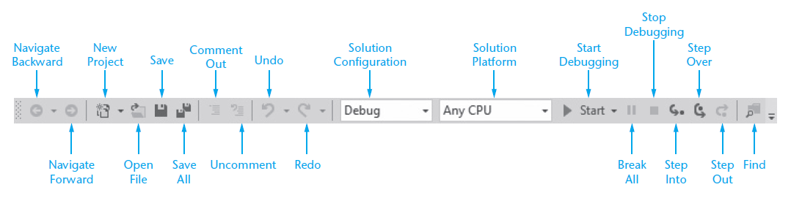
The Menu Bar and the Standard Toolbar (2 of 2)
The standard toolbar contains buttons that execute frequently used commands
Provides quick access to commands that would otherwise be executed from a menu

Slide 56
The Toolbox
The Toolbox is a window for selecting controls to use in an application’s user interface
Divided into sections such as All Windows Forms and Common Controls
To open a section, click on its name tab
To close a section, click on its name tab again
Move a section to the top by dragging its name with the mouse
The Toolbox typically appears on the left side of Visual Studio environment
If the toolbox is in Auto Hide mode
Clicking on the tab will display the window

Slide 57
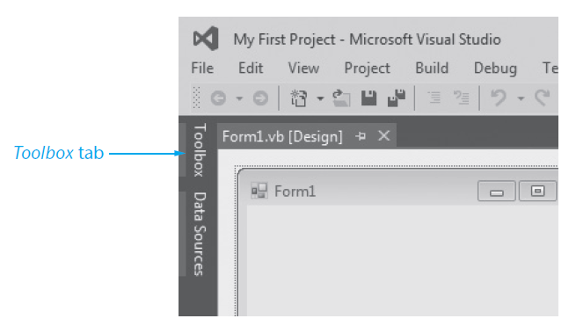
The Toolbox Tab (Auto Hide Turned on)

Slide 58
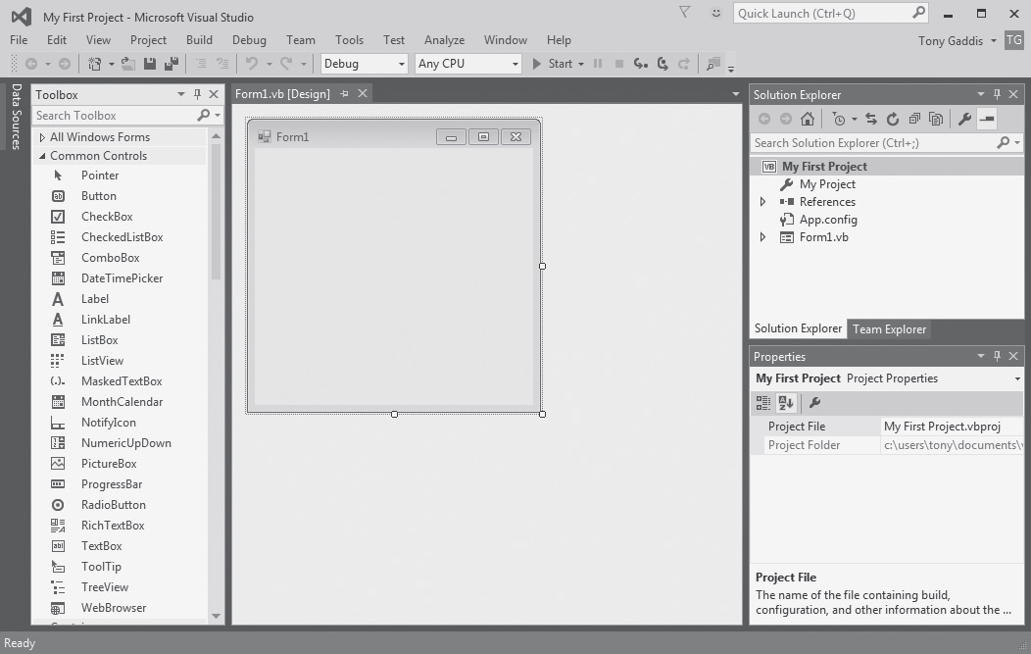
The Toolbox Opened (Auto Hide Turned off)

Slide 59
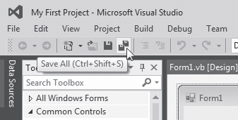
Using Tooltips
A ToolTip is a small rectangular box that pops up when you hover the mouse pointer over a button on the toolbar or Toolbox for a few seconds
Contains a short description of the button’s purpose
Use a ToolTip whenever you cannot remember a particular button’s function

Slide 60
Docked and Floating Windows
When a window is docked
It is attached to one of the edges of the Visual Studio environment
When a window is floating
You can resize the window as well as click and drag it by its title bar
Right-click a window’s title bar and select Float or Dock to change between floating or docked

Slide 61
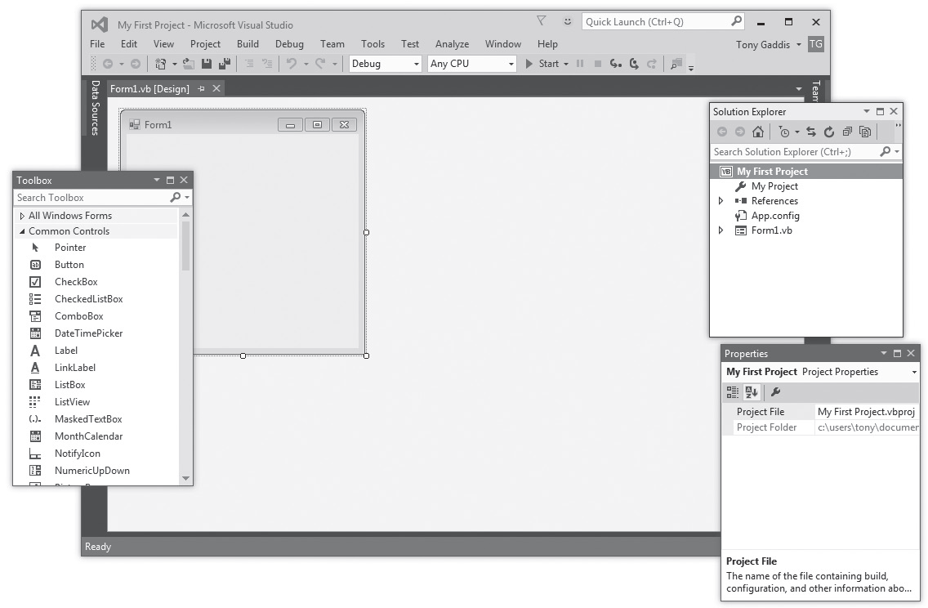
Floating Toolbox, Solution Explorer, and Properties Windows

Slide 62
Accessing the Visual Studio Documentation
Click Help on the menu bar and select View Help
Or simply press Ctrl + F1
This will launch your Web browser and open the online Microsoft Developer Network (M S D N) Library
View the complete documentation for Visual Basic and other programming languages
Find code samples, tutorials, articles, and Microsoft instructional videos

Slide 63

Copyright

